Slide 1

Sale Forecasting for ABC Manufacturing
DSP -06 Batch 2

Slide 2

Overview of Project
Understand sales trend for pesticides on domestic market by state wise
Analyze variables that impact the sales of the product.
Help ABC manufacturing to manage production to meet demand in market

Slide 3

Factor affecting sale forecasting
Rainfall,
GDP,
Population
We are studying rainfall effect in sale pesticides

Slide 4

Objective
Conduct state wise trend analysis of the given sales
To identify impact of rainfall on the Pesticide consumption trend
To provide state wise forecast of Pesticide sales for ABC Manufacturing for next 12 months

Slide 5
Steps to Forecast
To Understand the problem statement
By data interpretation prepared business case
To clean data and remove abnormal data from data set
To get rainfall data from reliable source
Analyse rainfall data
Analysis sale trend for state wise
Test the model and cross validate the data
Predict the relation between rainfall for state and sale of pesticide
Time series analysis to formulate forecasting model for sale of pesticide based on rainfall
Forecast sale for next 12 month for ABC Manufacturing

Slide 6
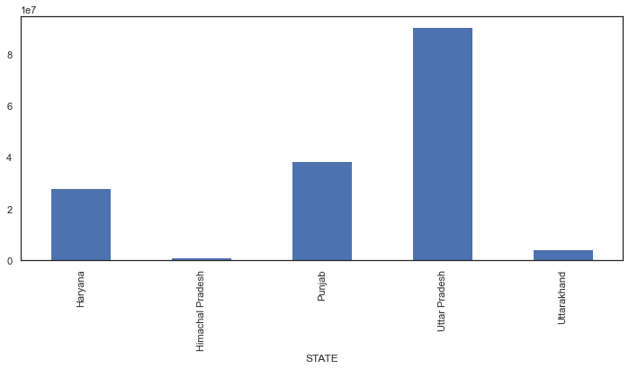
State Wise Sales trend 2014 - 2018
State wise Sale trend for pesticides shows that Uttar Pradesh has highest sales followed by Punjab and Haryana
Himachal Pradesh has lowest sell for pesticides

Slide 7
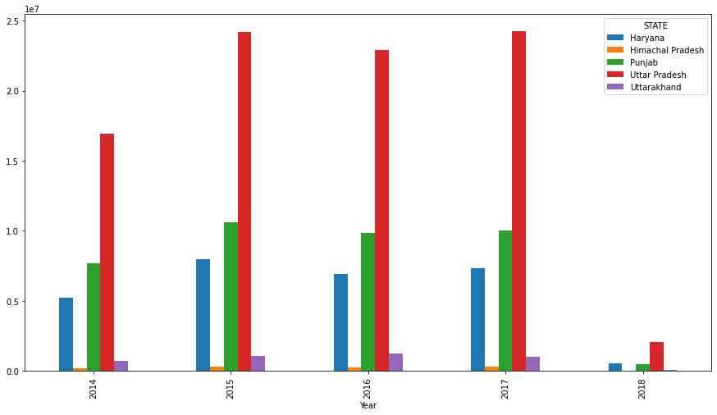
Year - State Wise Sales trend comparison 2014 - 2018
Every year Sales trend shows that sale of pesticides is high in Uttar Pradesh every year from 2014 – 2017, in 2018 only January sales data is available.
Punjab and Haryana follows the second and third ranking for sales of pesticides every year from 2014 - 2017, in 2018 both have nearly same sales.
Uttarakhand sales of pesticides follows the fourth ranking nearly same sales every year from 2014 – 2017, in 2018 mostly no sales in January.
Himachal Pradesh sales of pesticides follows the last ranking nearly same sales every year from 2014 – 2017, in 2018 no sales in January.

Slide 8
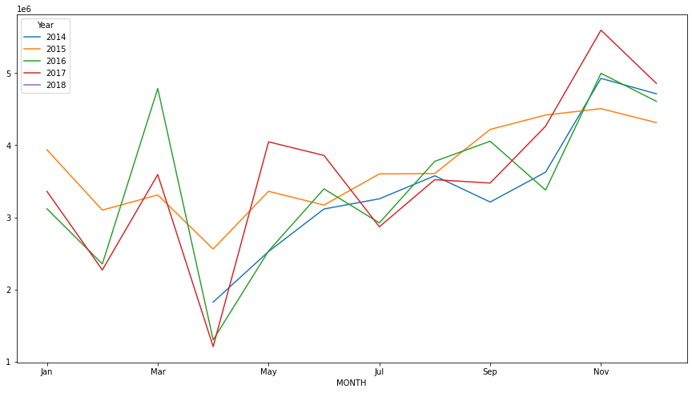
Yearly Sales trend 2014 - 2018
Year wise Sale trend for pesticides shows that during the first Quarter of the every year the sales are having rise and fall after that there is steady increase in every year
Every year April records lowest sell for pesticides. As it is financial year ending

Slide 9
EDA and Feature Engineering
Removed white spaces from data frame column
Removed the duplicates
Drop rows having the monthly sale equal to zeroes
Considered all FG goods as one group called ‘Pesticides”
Convert the year and month into date format
Used Pivot table and group by function to get visualization

Slide 10
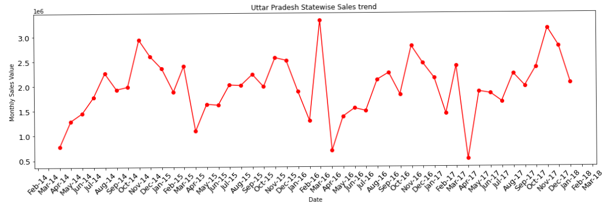
Month wise sale trend for Uttar Pradesh state
Uttar Pradesh has highest sales
Sales trend shows that from April to November sale of pesticides is in increasing trend and from November sale of pesticides is in decreasing trend until January every year from 2014 - 2018
Sales trend shows sudden spike of sales during the period around January to April every year 2014 - 2018.

Slide 11
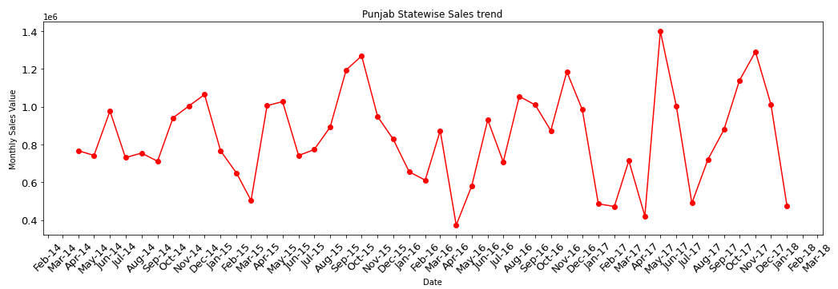
Month wise sale trend for Punjab state
Punjab has second highest sales
Sales trend shows that from April to Sep / Oct sale of pesticides is in increasing trend and from there sale of pesticides is in decreasing trend until Feb/Mar every year from 2014 - 2018
Sales trend shows lowest sales during the period around march every year 2014 - 2018.

Slide 12
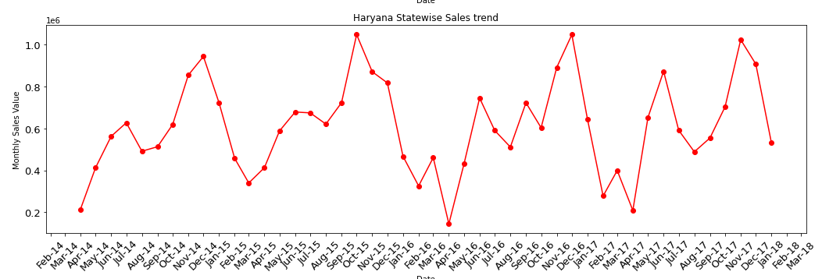
Month wise sale trend for Haryana state
Haryana has third highest sales
Sales trend shows that from April to Sep / Oct sale of pesticides is in increasing trend and from there sale of pesticides is in decreasing trend until Feb/Mar every year from 2014 - 2018
Sales trend shows lowest sales during the period around march every year 2014 - 2018.

Slide 13
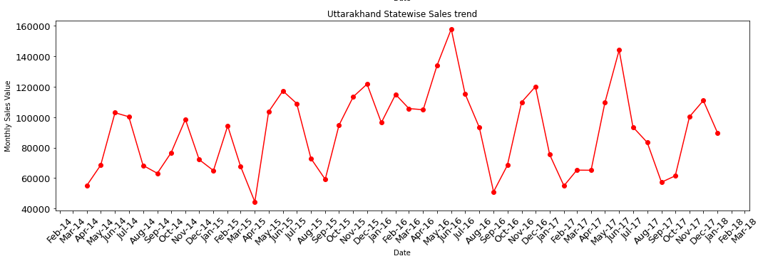
Month wise sale trend for Uttarakhand state
Uttarakand has fourth highest sales
Sales trend shows starting of financial year as lowest and mostly maintains uniformity of sale of pesticides during every financial year from 2014 - 2018
Sales trend shows sometimes lowest sales during the Aug / Sep in financial year 2014 - 2018.
Sales trend shows peak sales during May every financial year 2014 – 2018

Slide 14
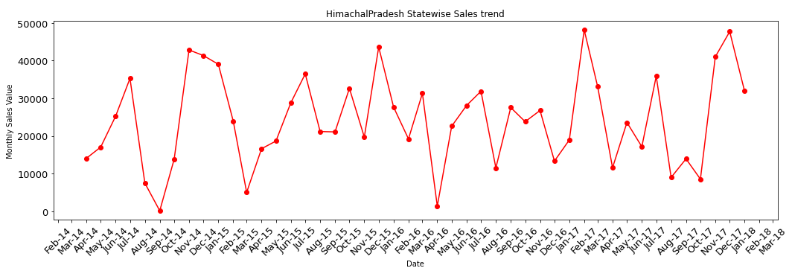
Month wise sale trend for Himachal Pradesh state
Himachal Pradesh has lowest sales
Sales trend shows starting of financial year as lowest and mostly maintains uniformity of sale of pesticides during every financial year from 2014 - 2018
Sales trend shows sometimes lowest sales during the Aug / Sep in financial year 2014 - 2018.

Slide 15
Rainfall Data Analysis
Extracted the rainfall data from the official site of state wise rainfall.
From extract data we selected state which related to our data set
Formatting dataset to used for study, by combining the east and west Uttar Pradesh rainfall data
Convert the year and month into date format
Used group by function to get visualization

Slide 16
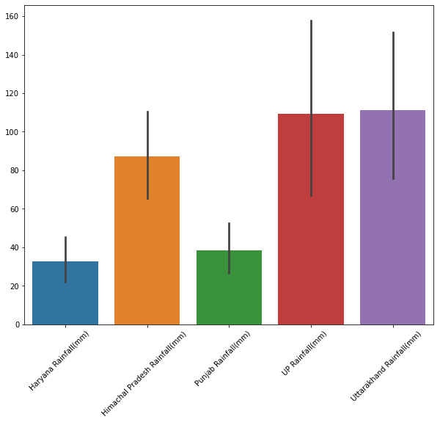
Rainfall Comparison in different states
Uttarakhand and Uttar Pradesh has the highest rainfall, but sales in the UP is highest and Uttarakhand also lowest.

Slide 17
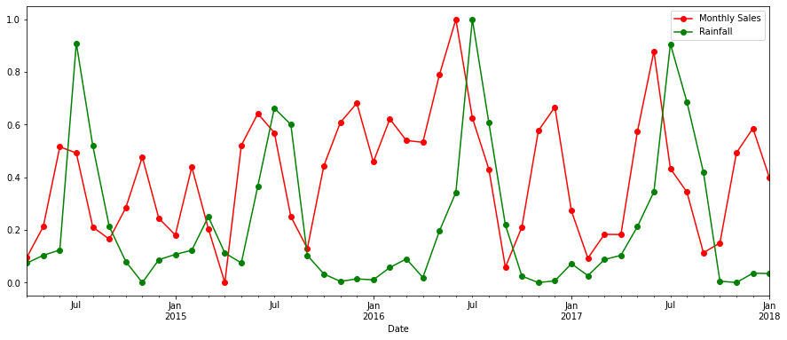
Rainfall correlation on Sale for Uttar Pradesh
Sales trend shows after the rainfall before the high rainfall the sale is drastically down and after rainfall sales is in increasing trend till before next rainfall season i.e. month of June

Slide 18
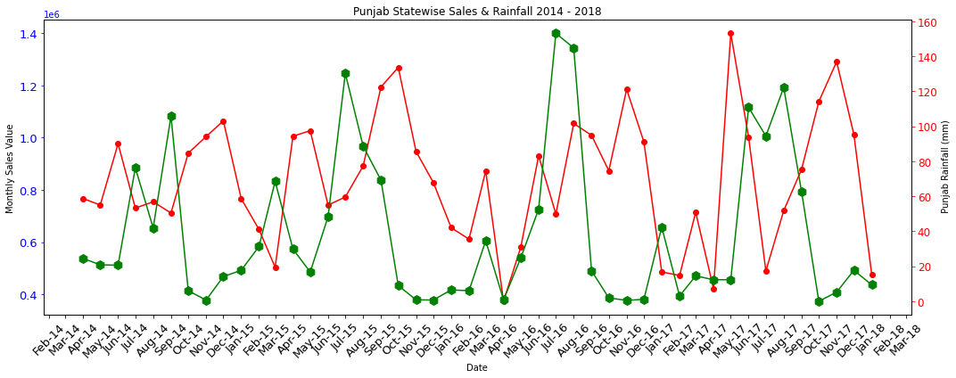
Rainfall correlation on Sale for Punjab
Sales trend shows after the rainfall before the high rainfall the sale is drastically down and after rainfall sales is in increasing trend till before next rainfall season

Slide 19
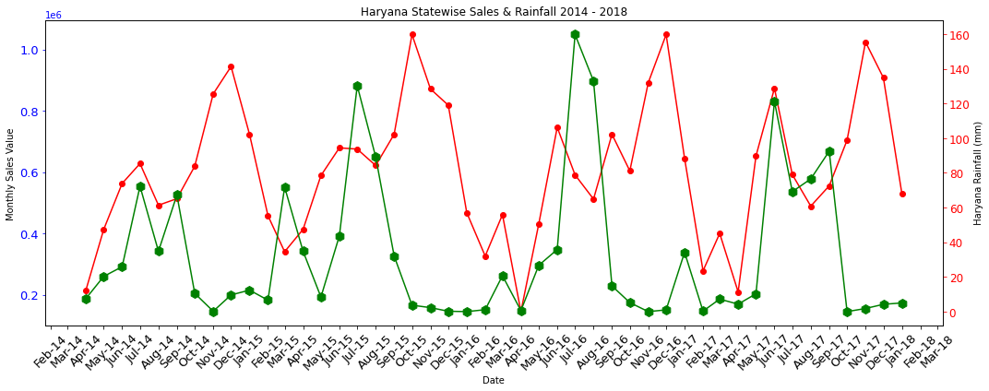
Rainfall correlation on Sale for Haryana
Sales trend shows after the rainfall before the high rainfall the sale is drastically down and after rainfall sales is in increasing trend till before next rainfall season i.e. month of June to Oct

Slide 20
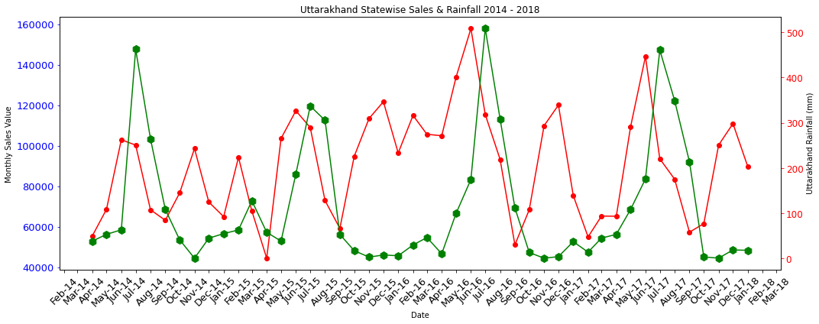
Rainfall correlation on Sale for Uttarakhand
Sales trend shows after the rainfall the sales pickup and drops down before the rainfall start again, mostly this cycle continues during whole year.

Slide 21
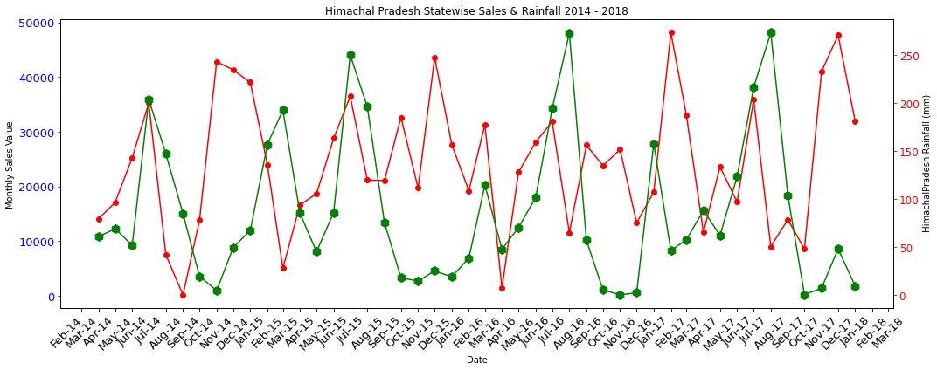
Rainfall correlation on Sale for Himachal Pradesh
Sales trend shows that the in month whare the rainfall is high sale is low

Slide 22
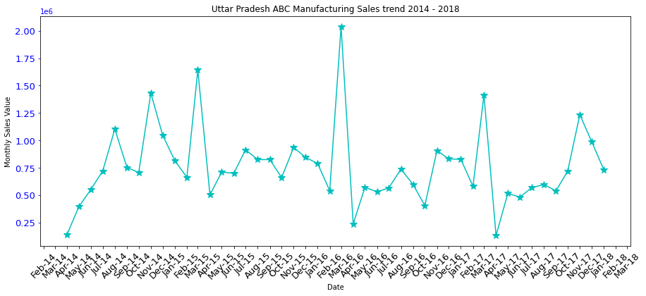
Sales trend for ABC Manufacturing In state of Uttar Pradesh
Sale trend for ABC Manufacturing shows that, it start increasing in first quarter and it continue in second quarter and down in 3rd quarter.
There is spike in month of march before quarter 1.

Slide 23
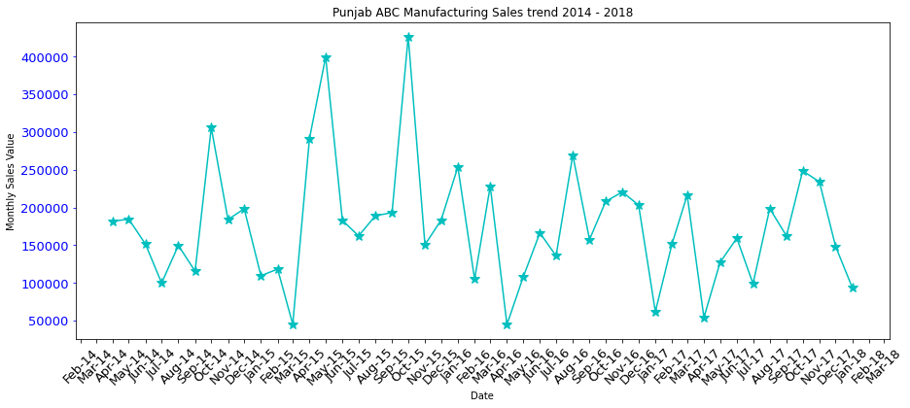
Sales trend for ABC Manufacturing In state of Punjab
Sales trend shows that from April to Sep / Oct sale of pesticides is in increasing trend and from there sale of pesticides is in decreasing trend until Feb/Mar every year from 2014 - 2018
Sales trend shows lowest sales during the period around march every year 2014 – 2018.

Slide 24
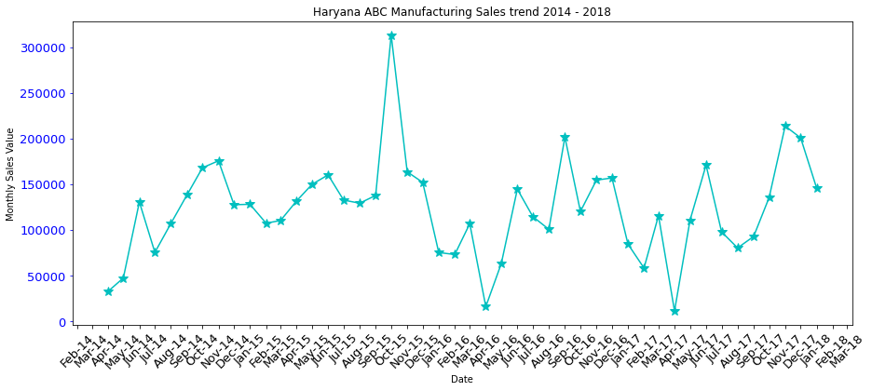
Sales trend for ABC Manufacturing In state of Haryana
Sales trend shows that from April to Sep / Oct sale of pesticides is in increasing trend and from there sale of pesticides is in decreasing trend until Feb/Mar every year from 2014 - 2018
Sales trend shows lowest sales during the period around march every year 2014 - 2018.

Slide 25
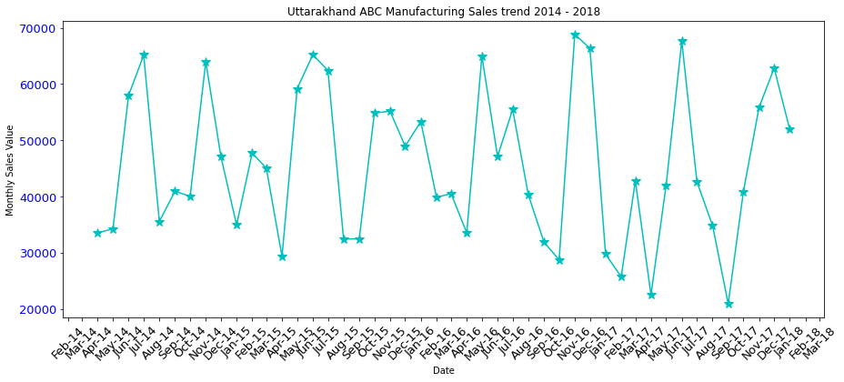
Month wise sale trend for Uttarakhand state
Uttarakhand has fourth highest sales
Sales trend shows starting of financial year as lowest and mostly maintains uniformity of sale of pesticides during every financial year from 2014 - 2018
Sales trend shows sometimes lowest sales during the Aug / Sep in financial year 2014 - 2018.
Sales trend shows peak sales during May every financial year 2014 – 2018

Slide 26
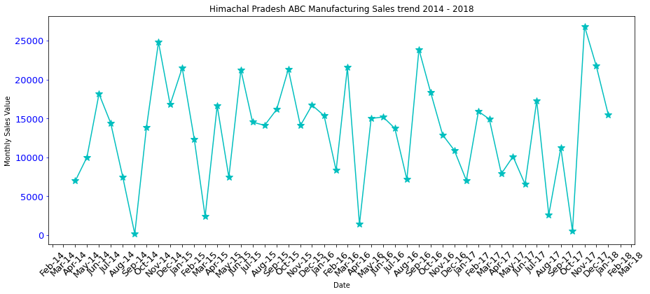
Month wise sale trend for Himachal Pradesh state
Himachal Pradesh has lowest sales
Sales trend shows starting of financial year as lowest and mostly maintains uniformity of sale of pesticides during every financial year from 2014 - 2018
Sales trend shows that sometimes lowest sales during the Mar / Aug in financial year 2014 - 2018.

Slide 27
Time series analysis
All these data for ABC Manufacturing for the 5 states is showing some patterns in the above plots.
In this model we are comparing the Sales with the time(that is successive sequence of regular time intervals). So we are going to use the Time Series Model.
We need to check our data using Decomposition method. Decomposition allows us to decompose the time series data into three distinct components.
Trend
Seasonality
Residual (Irregular)
This is a Additive Time Series, as we have a constant level plot, i.e. Trend + Seasonality + Residuals(Irregularities)

Slide 28
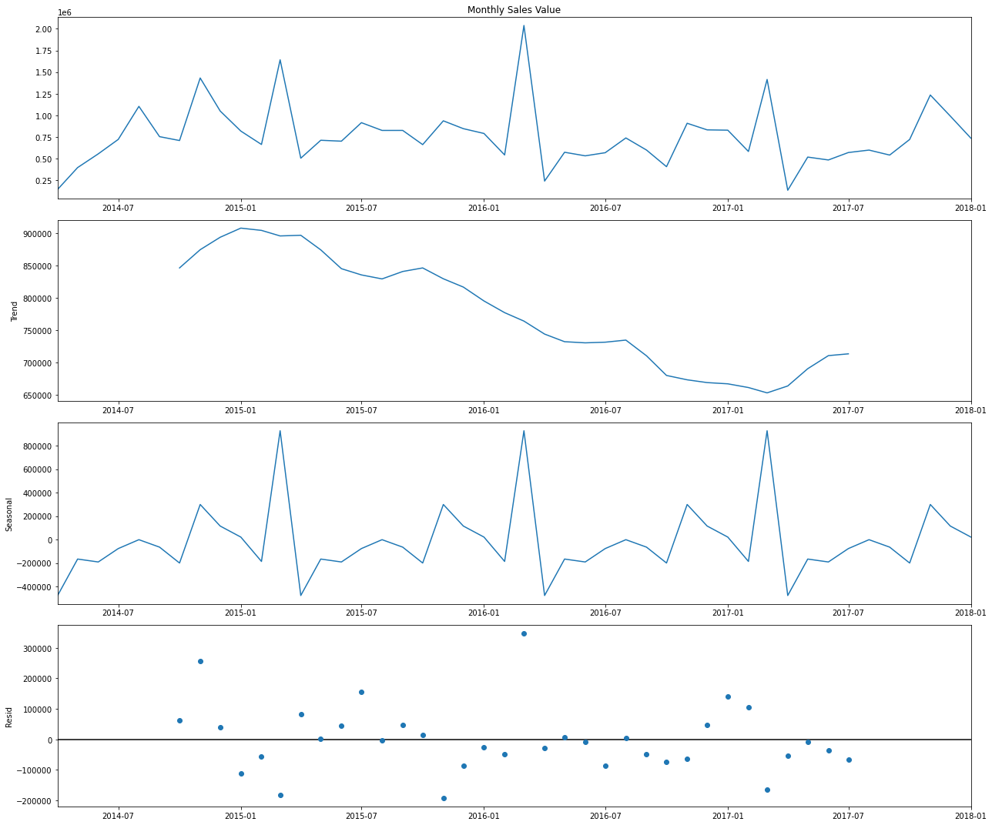
Decomposition of Time Series

Slide 29
Testing of Time series analysis
We check the decomposition for all states and the sales have some trend and seasonality for ABC Manufacturing company in each state.
We have tested the dataset to know whether the time series is stationery or not by using moving average and Augmented Dickey-Fuller Test.
We have used Holt Winter's Additive method, ARIMA & SARIMAX to Model time series dataset.
After that we have calculated the RMSE and MAPE accuracy methods to compare each model and found out that “SARIMAX is the best accuracy method for forecasting”.

Slide 30
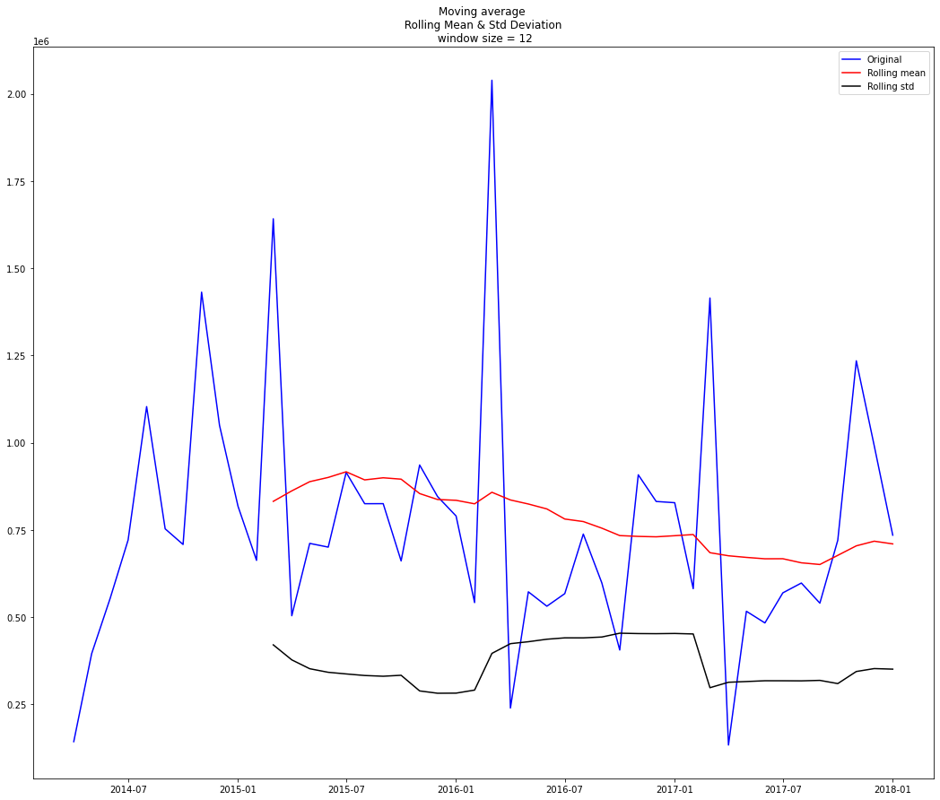
Uttar Pradesh Sale trend – Stationarity
In Above graph the red line shows Constant Mean, Black line shows constant Standard Deviation and blue line is sale trend over the time interval observation.
Because the we observe constant mean and constant standard deviation means the time series is stationary

Slide 31
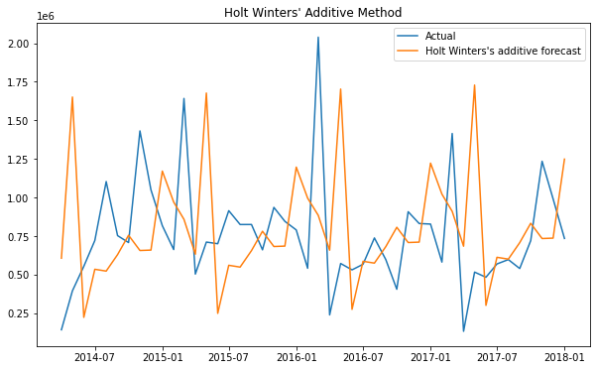
Forecasting Sales of Uttar Pradesh for the next 12 months
Using Holt Winter’s Model
In Holt Winters Model as the plot is parallel to X axis so it is additive model we have forecast for whole time series

Slide 32
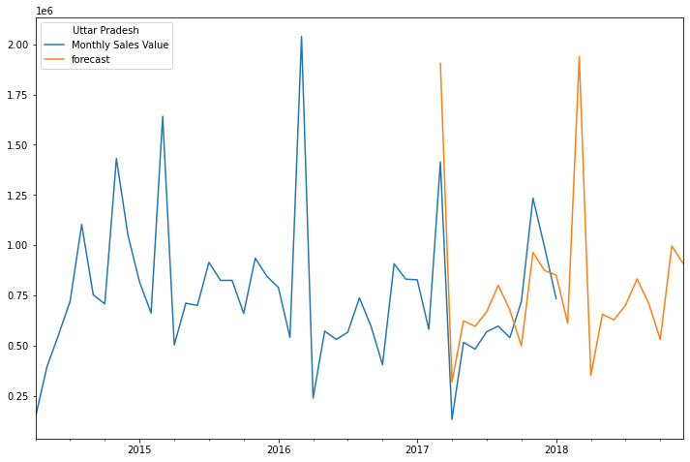
Forecasting Sales of Uttar Pradesh for the next 12 months
Using seasonal ARIMA
This Seasonal ARIMA forecasting for the next 12 months, shows the forecasting is showing similar trend and seasonality as previous observations.

Slide 33
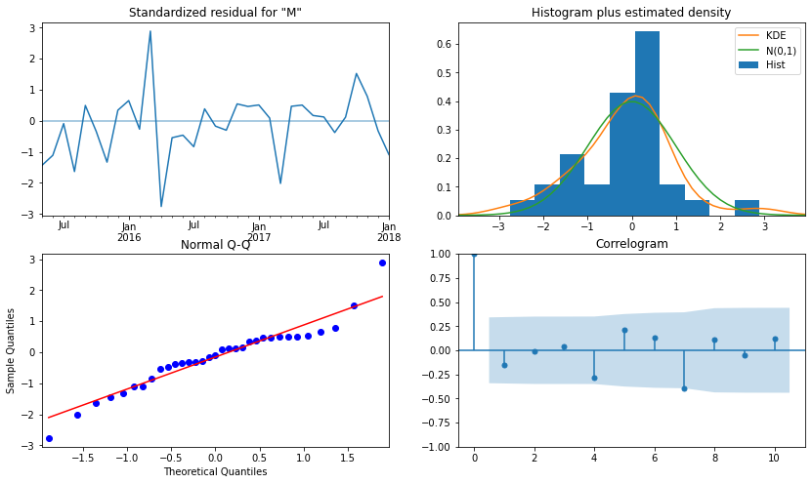
Plot diagnostics of SARIMAX
When fitting seasonal ARIMA models (and any other models for that matter), it is important to run model diagnostics to ensure that none of the assumptions made by the model have been violated. The plot diagnostics object allows us to quickly generate model diagnostics and investigate for any unusual behavior.
On the top left plot, the residuals of our model are uncorrelated and normally distributed with zero-mean.
On the top right plot, we see that the red KDE line follows closely with the N(0,1) line (where N(0,1)) is the standard notation for a normal distribution with mean 0 and standard deviation of 1). This is a good indication that the residuals are normally distributed.

Slide 34
Plot diagnostics of SARIMAX
The qq-plot on the bottom left shows that the ordered distribution of residuals (blue dots) follows the linear trend of the samples taken from a standard normal distribution with N(0, 1). Again, this is a strong indication that the residuals are normally distributed.
The residuals over time (top left plot) don’t display any obvious seasonality and appear to be white noise. This is confirmed by the autocorrelation (i.e. correlogram) plot on the bottom right, which shows that the time series residuals have low correlation with lagged versions of itself.

Slide 35
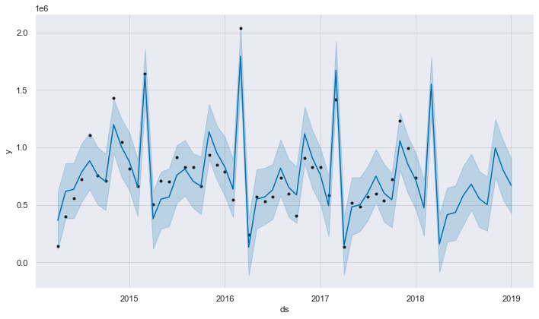
Forecasting Sales of Uttar Pradesh for the next 12 months
Using FB Prophet
In this plot black dots are the Actual Sales Values, Blue line is the predicted line and it is predicted for next 365 days also. The blue space around the blue line is the Trend

Slide 36
Conclusion for Time Series Model for Forecasting
The performance of the models were evaluated using RMSE & MAPE.
According to our observation, the RMSE & MAPE for Holt Winters, Seasonal ARIMA is more than FbProphet modeling for Uttar Pradesh Pesticides Sales. So, we can go ahead with Fb Prophet model.

Slide 37
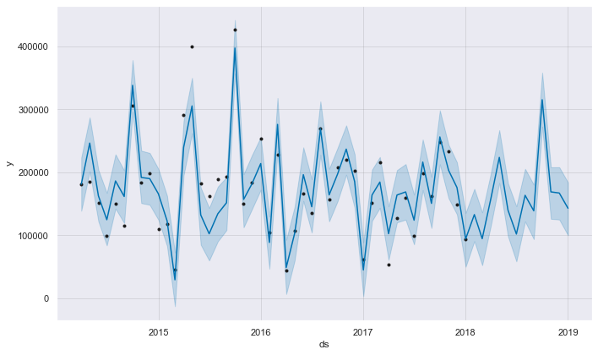
Forecasting Sales of Punjab for the next 12 months Using FB Prophet
In this plot black dots are the Actual Sales Values, Blue line is the predicted line and it is predicted for next 365 days also. The blue space around the blue line is the Trend

Slide 38
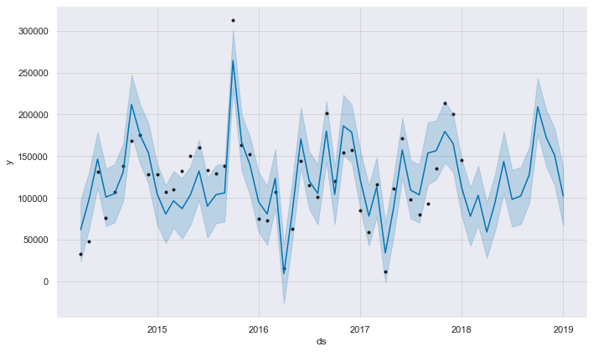
Forecasting Sales of Haryana for the next 12 months Using FB Prophet
In this plot black dots are the Actual Sales Values, Blue line is the predicted line and it is predicted for next 365 days also. The blue space around the blue line is the Trend

Slide 39
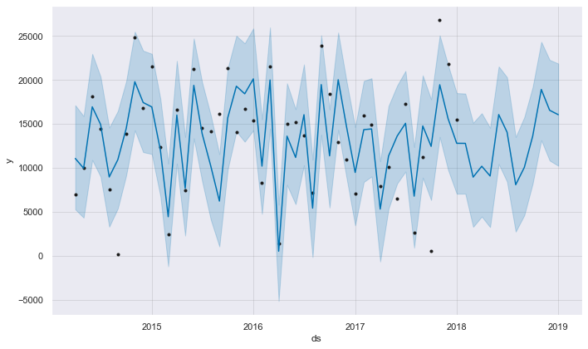
Forecasting Sales of Himachal Pradesh for the next 12 months Using FB Prophet
In this plot black dots are the Actual Sales Values, Blue line is the predicted line and it is predicted for next 365 days also. The blue space around the blue line is the Trend

Slide 40
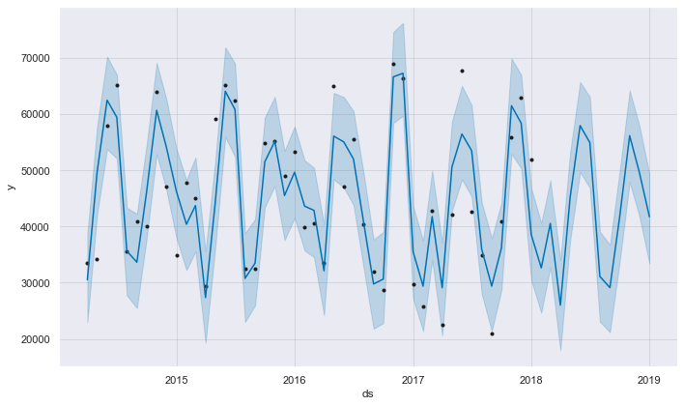
Forecasting Sales of Uttarakhand for the next 12 months Using FB Prophet
In this plot black dots are the Actual Sales Values, Blue line is the predicted line and it is predicted for next 365 days also. The blue space around the blue line is the Trend

Slide 41
Performance & Estimated Monetary for ABC Manufacturing Pesticide Sales
The performance of the models were evaluated using RMSE & MAPE for all the States using FbProphet model.
We use RMSE as the minimum value to impact the pesticides sales. i.e. the amount which the company can save.
Estimated monetary impact of ABC Manufacturing for Uttar Pradesh – Rs146480.61
Estimated monetary impact of ABC Manufacturing for Punjab – Rs 21739.85
Estimated monetary impact of ABC Manufacturing for Haryana– Rs40521.41
Estimated monetary impact of ABC Manufacturing for Himachal Prdaesh – Rs7870.20
Estimated monetary impact of ABC Manufacturing for Uttarakhand– Rs6019.32

